Slide 1
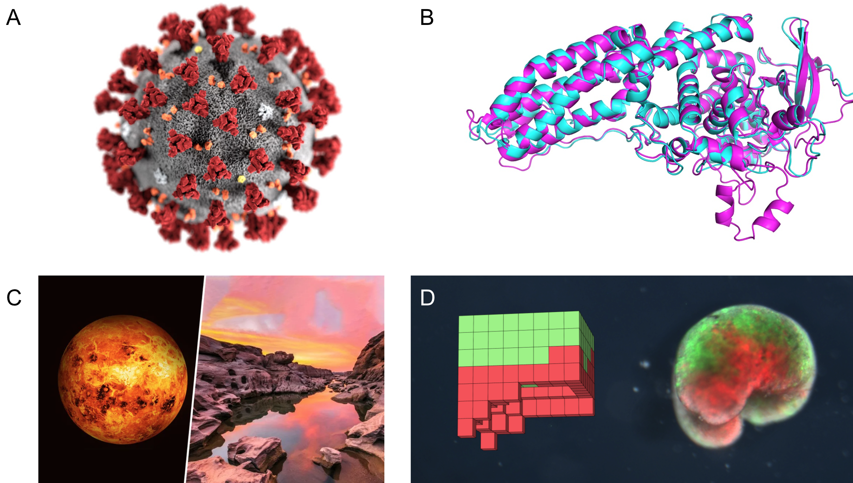
CS206
Evolutionary Robotics
Notes:
A – Covid Vaccine
B – Protein folding problem solved by google deep mind (alpha fold)
C – Phosphine found in atmosphere of Venus (evidence of life)
D – Zenobots, living robots

Slide 2
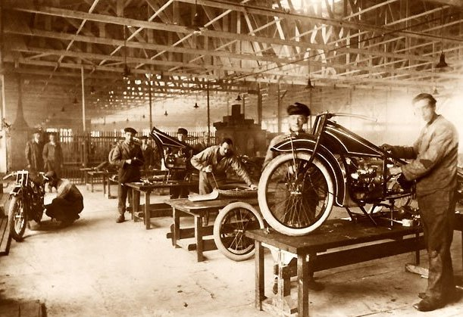
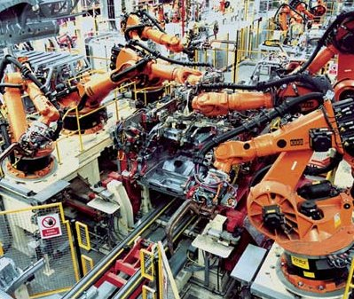
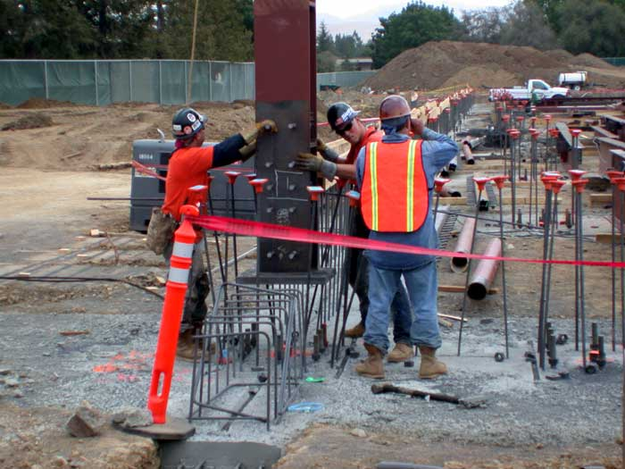
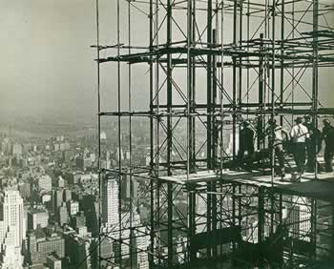
CS206
Evolutionary Robotics
L01
Why Robots?
Notes:
Robots replace labor vs supplementing labor
Mass production, Henry Ford
No outdoor robots: safety, uncontrolled variables
Robots cannot adapt to their environment

Slide 3
CS206
Evolutionary Robotics
L01
Why Robots?
It is one of the few ‘open frontiers’ in science:
There is no guiding theory about intelligence
Guiding theory in biology: evolution
Guiding theory in physics: Newtonian and quantum mechanics
Guiding theory in chemistry: …
…
There are several Nobel Prizes waiting to be won in this field.
It is one of the most interdisciplinary areas of study:
Evolutionary biology
Neuroscience
Cognitive science
Psychology
Biomechanics
Physics
Computer Science
Mechanical engineering, electrical engineering, bio-engineering
Chemistry
Mathematics
Philosophy (of mind)

Slide 4

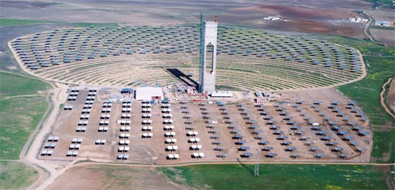
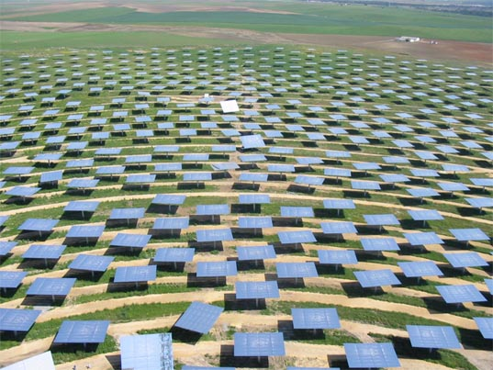

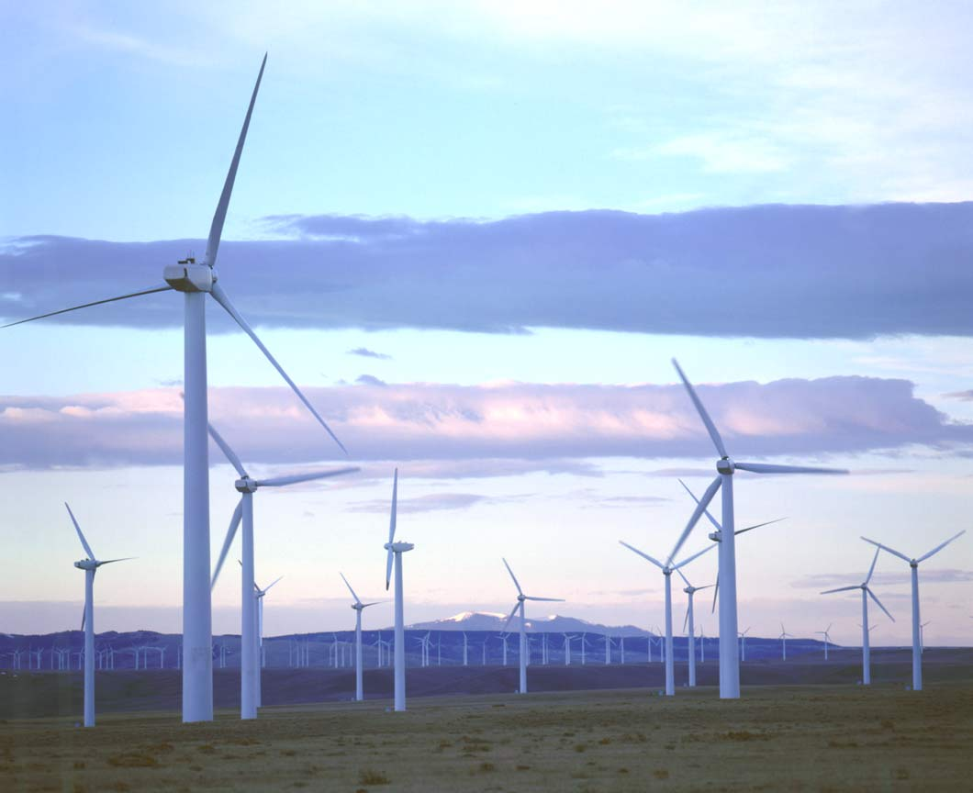
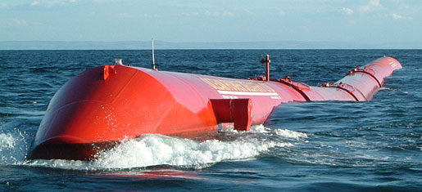
CS206
Evolutionary Robotics
L01
Large-scale
outdoor infrastructure:
Wind farms,
Solar farms,
Wave farms,
Tide farms,
…
Why Robots Outside?

Slide 5
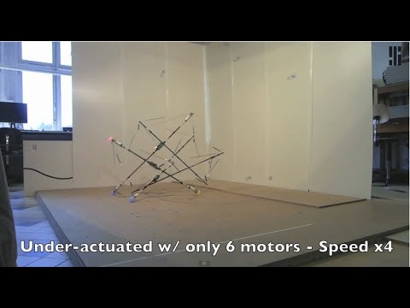
CS206
Evolutionary Robotics
L01
NASA’s Tensegrity Robot: The future of evolutionary robotics?

Slide 6
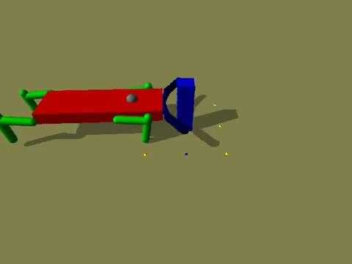
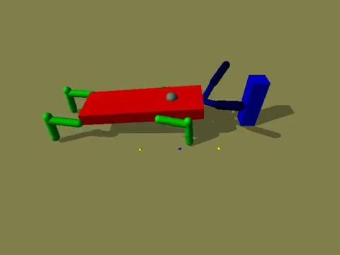
CS206
Evolutionary Robotics
L01
Anatomy of an evolutionary robotics experiment:
Create a task environment.
Create the robot.
Create the robot’s brain, or Artificial Neural Network (ANN).
Use an evolutionary algorithm to optimize the ANN so that the robot performs the desired task in its environment.
Notes:
4 elements in evolutionary robotics
1 task environment – simulated or physical
2 Robot body
3 Brain –artificial neural network
4 Evolutionary algorithm

Slide 7
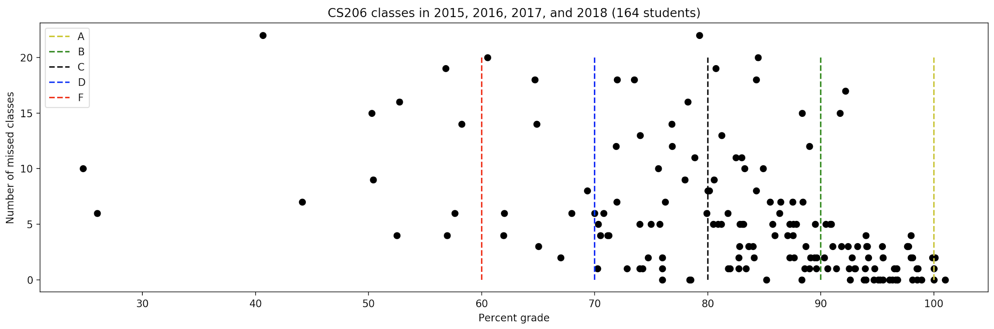
CS206
Evolutionary Robotics
L01
Here’s why you should come to class.

Slide 8
CS206
Evolutionary Robotics
L01
Who I am:
1993 – 1997: Undergraduate in Computer Science from
McMaster University, Hamilton, Canada
1997 – 1998: Software Engineer,
Computing Devices Canada, Calgary, Canada
1998 – 1999: MSc in Evolutionary and Adaptive Systems from
Sussex University, Brighton, England
1999 – 2003: PhD in Mathematical and Physical Sciences from
University of Zurich, Switzerland
2003 – 2006: Postdoctoral work at
Cornell University, Ithaca, NY
Present: Professor, UVM

Slide 9
CS206
Evolutionary Robotics
L01
What I expect from you:
Feedback
Common sense
Regular, not necessarily perfect attendance
Hard work
Memorization of key concepts (job interviews are closed-book)
Creativity
Self - learning
A positive attitude when working with me, the TA, or fellow students.

Slide 10
CS206
Evolutionary Robotics
L01
What you _cannot_ expect from me:
Help with buggy code
(eg. “Why is my program crashing?”)
Help with learning a programming language, installing software, etc.

Slide 11

CS206
Evolutionary Robotics
L01
What you _can_ expect from me:
Help with _specific_ programming questions…
(eg. “Why do I need to deallocate memory?”)
… but only after you’ve consulted online resources
and your peers.
(Google “Python tutorial”)
www.codecademy.com
Help with conceptual issues
(“Can you go over the genetic algorithm again?”)
Clarification about the assignments / project
An emphasis on concepts, rather than specific tools,
because tools change, but concepts change more slowly.

Slide 12
CS206
Evolutionary Robotics
L01
Weeks 1 to 10: Complete 10 cumulative programming assignments:
Blackboard
Assignments
Assignment 1

Slide 13
CS206
Evolutionary Robotics
L01
Weeks 1 to 10: Complete 10 cumulative programming assignments:
Blackboard
Assignments
Assignment 1
reddit.com/r/ludobots
Step A: Installation

Slide 14
CS206
Evolutionary Robotics
L01
Weeks 1 to 10: Complete 10 cumulative programming assignments:
Blackboard
Assignments
Assignment 1
Git repository:
CS206
reddit.com/r/ludobots
Step A: Installation

Slide 15
CS206
Evolutionary Robotics
L01
Weeks 1 to 10: Complete 10 cumulative programming assignments:
Blackboard
Assignments
Assignment 1
Git repository:
CS206
reddit.com/r/ludobots
Step A: Installation
reddit.com/r/ludobots
Step B: Simulation

Slide 16
CS206
Evolutionary Robotics
L01
Weeks 1 to 10: Complete 10 cumulative programming assignments:
Blackboard
Assignments
Assignment 1
Git repository:
CS206
reddit.com/r/ludobots
Step A: Installation
branch:
Simulation
reddit.com/r/ludobots
Step B: Simulation

Slide 17
CS206
Evolutionary Robotics
L01
Weeks 1 to 10: Complete 10 cumulative programming assignments:
Blackboard
Assignments
Assignment 1
Git repository:
CS206
reddit.com/r/ludobots
Step A: Installation
branch:
Simulation
reddit.com/r/ludobots
Step B: Simulation
YouTube upload B

Slide 18
CS206
Evolutionary Robotics
L01
Weeks 1 to 10: Complete 10 cumulative programming assignments:
Blackboard
Assignments
Assignment 1
Git repository:
CS206
reddit.com/r/ludobots
Step A: Installation
branch:
Simulation
reddit.com/r/ludobots
Step B: Simulation
YouTube upload B
reddit submission B

Slide 19
CS206
Evolutionary Robotics
L01
Weeks 1 to 10: Complete 10 cumulative programming assignments:
Blackboard
Assignments
Assignment 1
Git repository:
CS206
reddit.com/r/ludobots
Step A: Installation
branch:
Simulation
reddit.com/r/ludobots
Step B: Simulation
YouTube upload B
reddit submission B
branch:
OneLink
reddit.com/r/ludobots
Step C: One Link
YouTube upload C
reddit submission C

Slide 20
After 10 weeks:
evolve.py
evolve.py
genome₁
genome₂
...
genome_{n}
genome₁
genome₂
...
genome_{n}
Brain1
Body1
World1
pyrosim / pyrosim.py
brain.nndf
body.urdf
world.sdf
fitness1.p
simulate.py
pyrosim /
neuralNetwork.py
pybullet.py
(Python)
pyrosim /
neuron.py
pyrosim / synapse.py
bullet.cpp
(C++)
Sensors
Sensor
neurons
Hidden
neurons
Motor
neurons
Motors
Joints
Links
Links
Sensor
values
Synapses
Synapses
Desired
angles
Forces
Forces
Forces

Slide 21
After 1 week:
evolve.py
evolve.py
genome₁
genome₂
...
genome_{n}
genome₁
genome₂
...
genome_{n}
Brain1
Body1
World1
pyrosim / pyrosim.py
brain.nndf
body.urdf
world.sdf
fitness1.p
simulate.py
ludobots /
neuralNetwork.py
pybullet.py
(Python)
ludobots /
neuron.py
ludobots / synapse.py
bullet.cpp
(C++)
Sensors
Sensor
neurons
Hidden
neurons
Motor
neurons
Motors
Joints
Links
Links
Sensor
values
Synapses
Synapses
Desired
angles
Forces
Forces
Forces

Slide 22
After 1 week:
evolve.py
evolve.py
genome₁
genome₂
...
genome_{n}
genome₁
genome₂
...
genome_{n}
Brain1
Body1
World1
pyrosim / pyrosim.py
brain.nndf
body.urdf
world.sdf
fitness1.p
simulate.py
ludobots /
neuralNetwork.py
pybullet.py
(Python)
ludobots /
neuron.py
ludobots / synapse.py
bullet.cpp
(C++)
Sensors
Sensor
neurons
Hidden
neurons
Motor
neurons
Motors
Joints
Links
Links
Sensor
values
Synapses
Synapses
Desired
angles
Forces
Forces
Forces

Slide 23
After 1 week:
generate.py
evolve.py
genome₁
genome₂
...
genome_{n}
genome₁
genome₂
...
genome_{n}
Brain1
Body1
World1
pyrosim / pyrosim.py
brain.nndf
body.urdf
world.sdf
fitness1.p
simulate.py
ludobots /
neuralNetwork.py
pybullet.py
(Python)
ludobots /
neuron.py
ludobots / synapse.py
bullet.cpp
(C++)
Sensors
Sensor
neurons
Hidden
neurons
Motor
neurons
Motors
Joints
Links
Links
Sensor
values
Synapses
Synapses
Desired
angles
Forces
Forces
Forces

Slide 24
CS206
Evolutionary Robotics
L01
Weeks 11 to 14: Use the system to conduct an evolutionary robotics experiment.
Given the same optimizer, neural network and eight hours of behavior optimization on the same computer, does a quadrupedal robot evolve to walk further or not as far as a hexapedal robot, or is there no significant difference?
2. Create five fitness functions that not only select for locomotion on the quadrupedal robot, but each also selects for a particular gait: walking, trotting, canter, galloping and pronking.
3. Create a fitness function that rewards NNs for locomotion, but penalizes them for requiring a lot of energy to realize the gait. This is difficult, as there are two solutions that are not desirable: evolution finds fast but inefficient gaits, or ‘gaits’ in which the robot does not move, and therefore does not consume energy.
4. Equip the robot with a simulated laser range finder, which tells the robot about objects in its environment. Evolve a robot that walks toward round objects, but walks away from rectangular objects.
5. Past student projects: whegs. Soccer bot. Basketball bot. Billiard bot. Thrower.

Slide 25
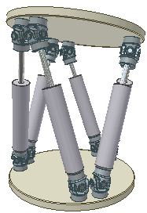
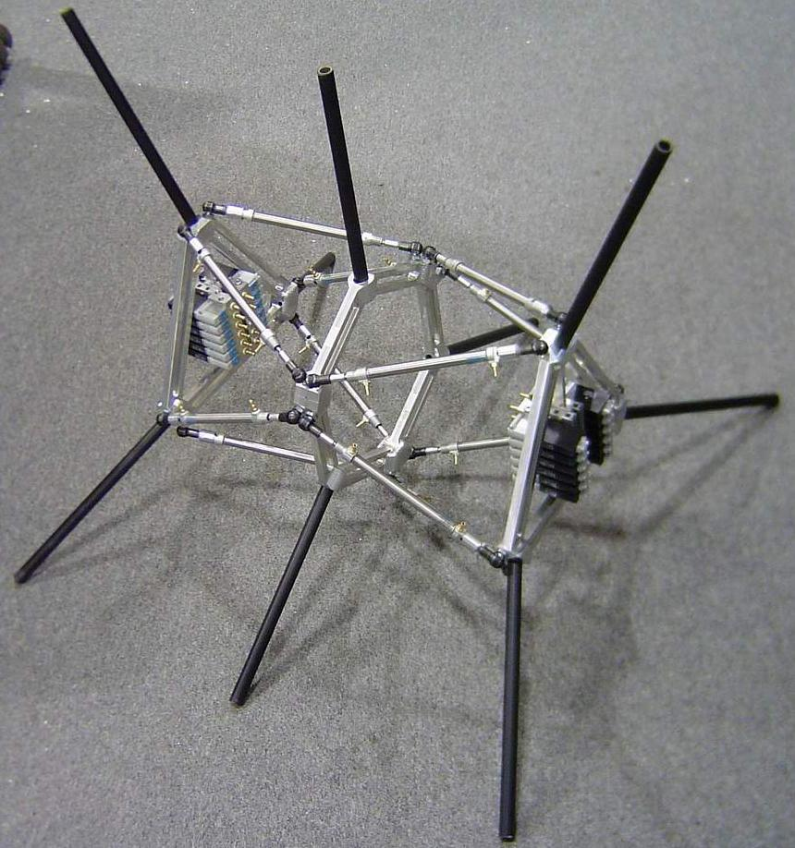
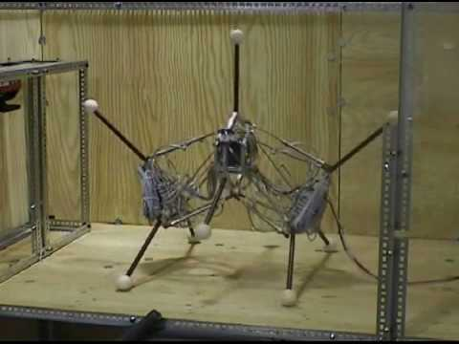
CS206
Evolutionary Robotics
L01
t1 t2 t3 t4 t5 t6 t7 t8 …
m1 +1 +1 +1 +1 +1 -1 +1 -1 …
m2 -1 +1 +1 +1 -1 +1 +1 +1 …
m3 +1 +1 +1 -1 +1 +1 -1 +1 …
m4 +1 -1 +1 +1 -1 +1 +1 -1 …
…
Why Evolutionary Robotics?
Creating a controller for a
robot is non-intuitive:
requires automation

Slide 26
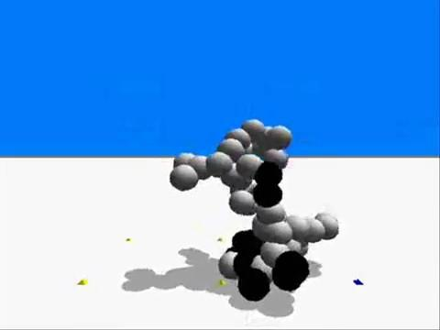
CS206
Evolutionary Robotics
L01
Why Evolutionary Robotics?
Creating a controller for a robot is non-intuitive: requires automation
Learning algorithms only optimize controllers;
evolution can optimize the whole robot.

Slide 27
CS206
Evolutionary Robotics
L01
Why Evolutionary Robotics?
Creating a controller for a robot is non-intuitive: requires automation
Learning algorithms only optimize controllers;
evolution can optimize the whole robot.
?

Slide 28
CS206
Evolutionary Robotics
L01
Why Evolutionary Robotics?
Creating a controller for a robot is non-intuitive: requires automation
Learning algorithms only optimize controllers;
evolution can optimize the whole robot.
?

Slide 29
CS206
Evolutionary Robotics
L01
Why Evolutionary Robotics?
Creating a controller for a robot is non-intuitive: requires automation
Learning algorithms only optimize controllers;
evolution can optimize the whole robot.
?
?

Slide 30
CS206
Evolutionary Robotics
L01
Why Evolutionary Robotics?
Creating a controller for a robot is non-intuitive: requires automation
Learning algorithms only optimize controllers;
evolution can optimize the whole robot.
?
?

Slide 31
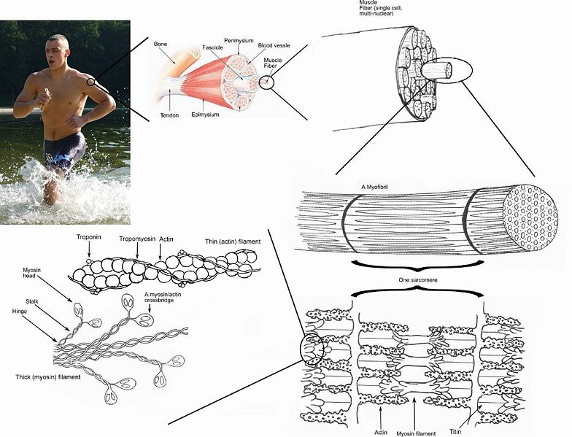
CS206
Evolutionary Robotics
L01
Why Evolutionary Robotics?
Creating a controller for a robot is non-intuitive: requires automation
Learning algorithms only optimize controllers;
evolution can optimize the whole robot.
3. Biological evolution produced
adaptive agents of unparalleled
complexity with no supervision.

Slide 32

CS206
Evolutionary Robotics
L01
Why Evolutionary Robotics?
Creating a controller for a robot is non-intuitive: requires automation
Learning algorithms only optimize controllers;
evolution can optimize the whole robot.
3. Biological evolution produced
adaptive agents of unparalleled
complexity with no supervision.
4. Most learning algorithms require detailed supervision:
t1 t2 t3 t4 t5 t6 t7 t8 …
m1 +1 +1 +1 +1 +1 -1 +1 -1 …
m2 -1 +1 +1 +1 -1 +1 +1 +1 …
m3 +1 +1 +1 -1 +1 +1 -1 +1 …
m4 +1 -1 +1 +1 -1 +1 +1 -1 …
…
Should have been ‘+1’

Slide 33
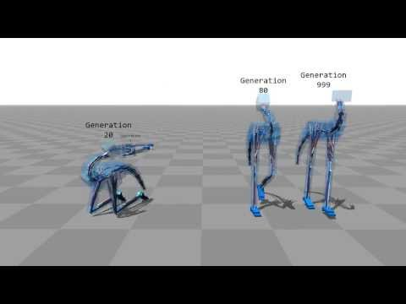
CS206
Evolutionary Robotics
L01
Why Evolutionary Robotics?

